Slide 1
Electronic System Design 3003 Lecture: Grounding
Dr Sajjad Hussain
Thanks to Prof. Duncan Bremner
Sajjad.Hussain.2@glasgow.ac.uk

Slide 2

There is no ground.
Electricity leaves the battery, does something useful and then returns to the battery.
It doesn’t flow away into a “ground puddle”….
Signals flow on two wires

Slide 3
Grounding and Common-Mode Rejection
Have assumed connections between components are ideal
Untrue: Wires have significant impedance:
Calculate resistance of PCB track:-
Resistivity of copper
1.69µΩ-cm (20°C)

Slide 4
Common-Mode Signals
Typical signal wires have resistances ~0.1Ω = 100mΩ
Typical signal currents ~ 10V / 10kΩ =1mA -> 100µV!
BAD!!
Notes:
0.1Ω=0.1×1000mΩ=100mΩ

Slide 5
PCB Layout
Ground
i_{Load}
Voltage drop!
i_{Load}

Slide 6
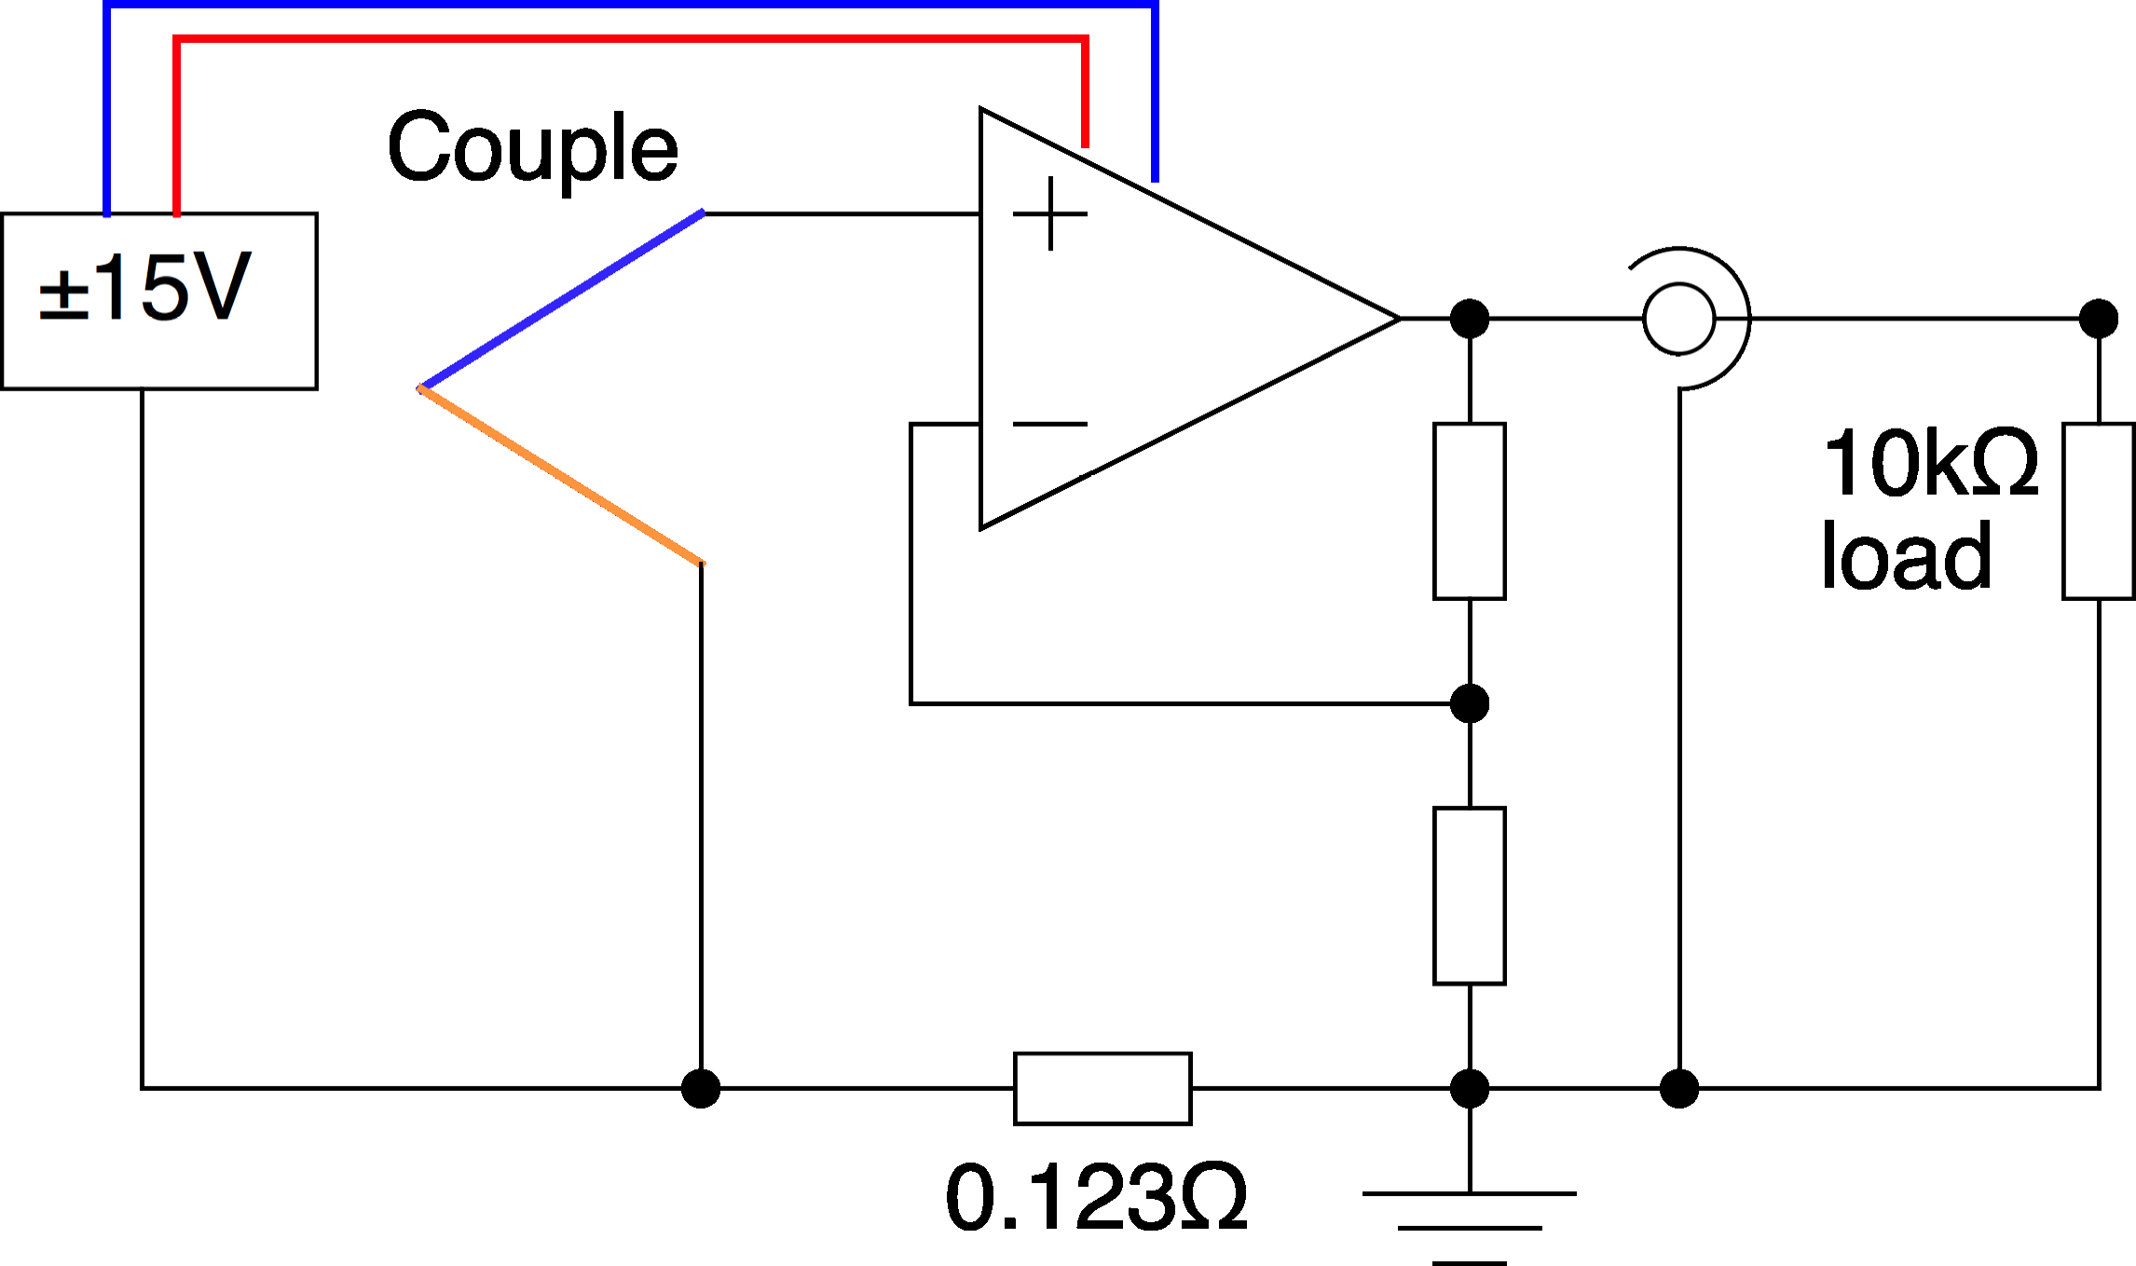
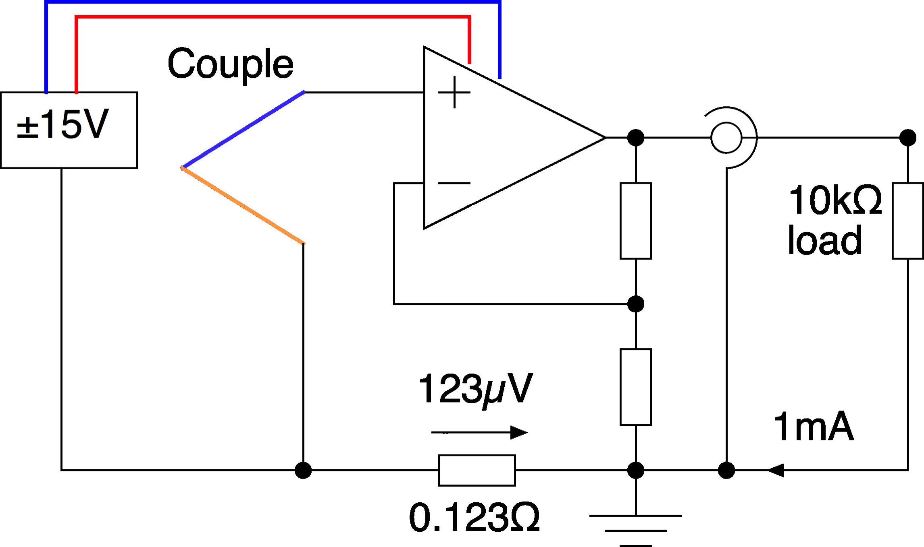
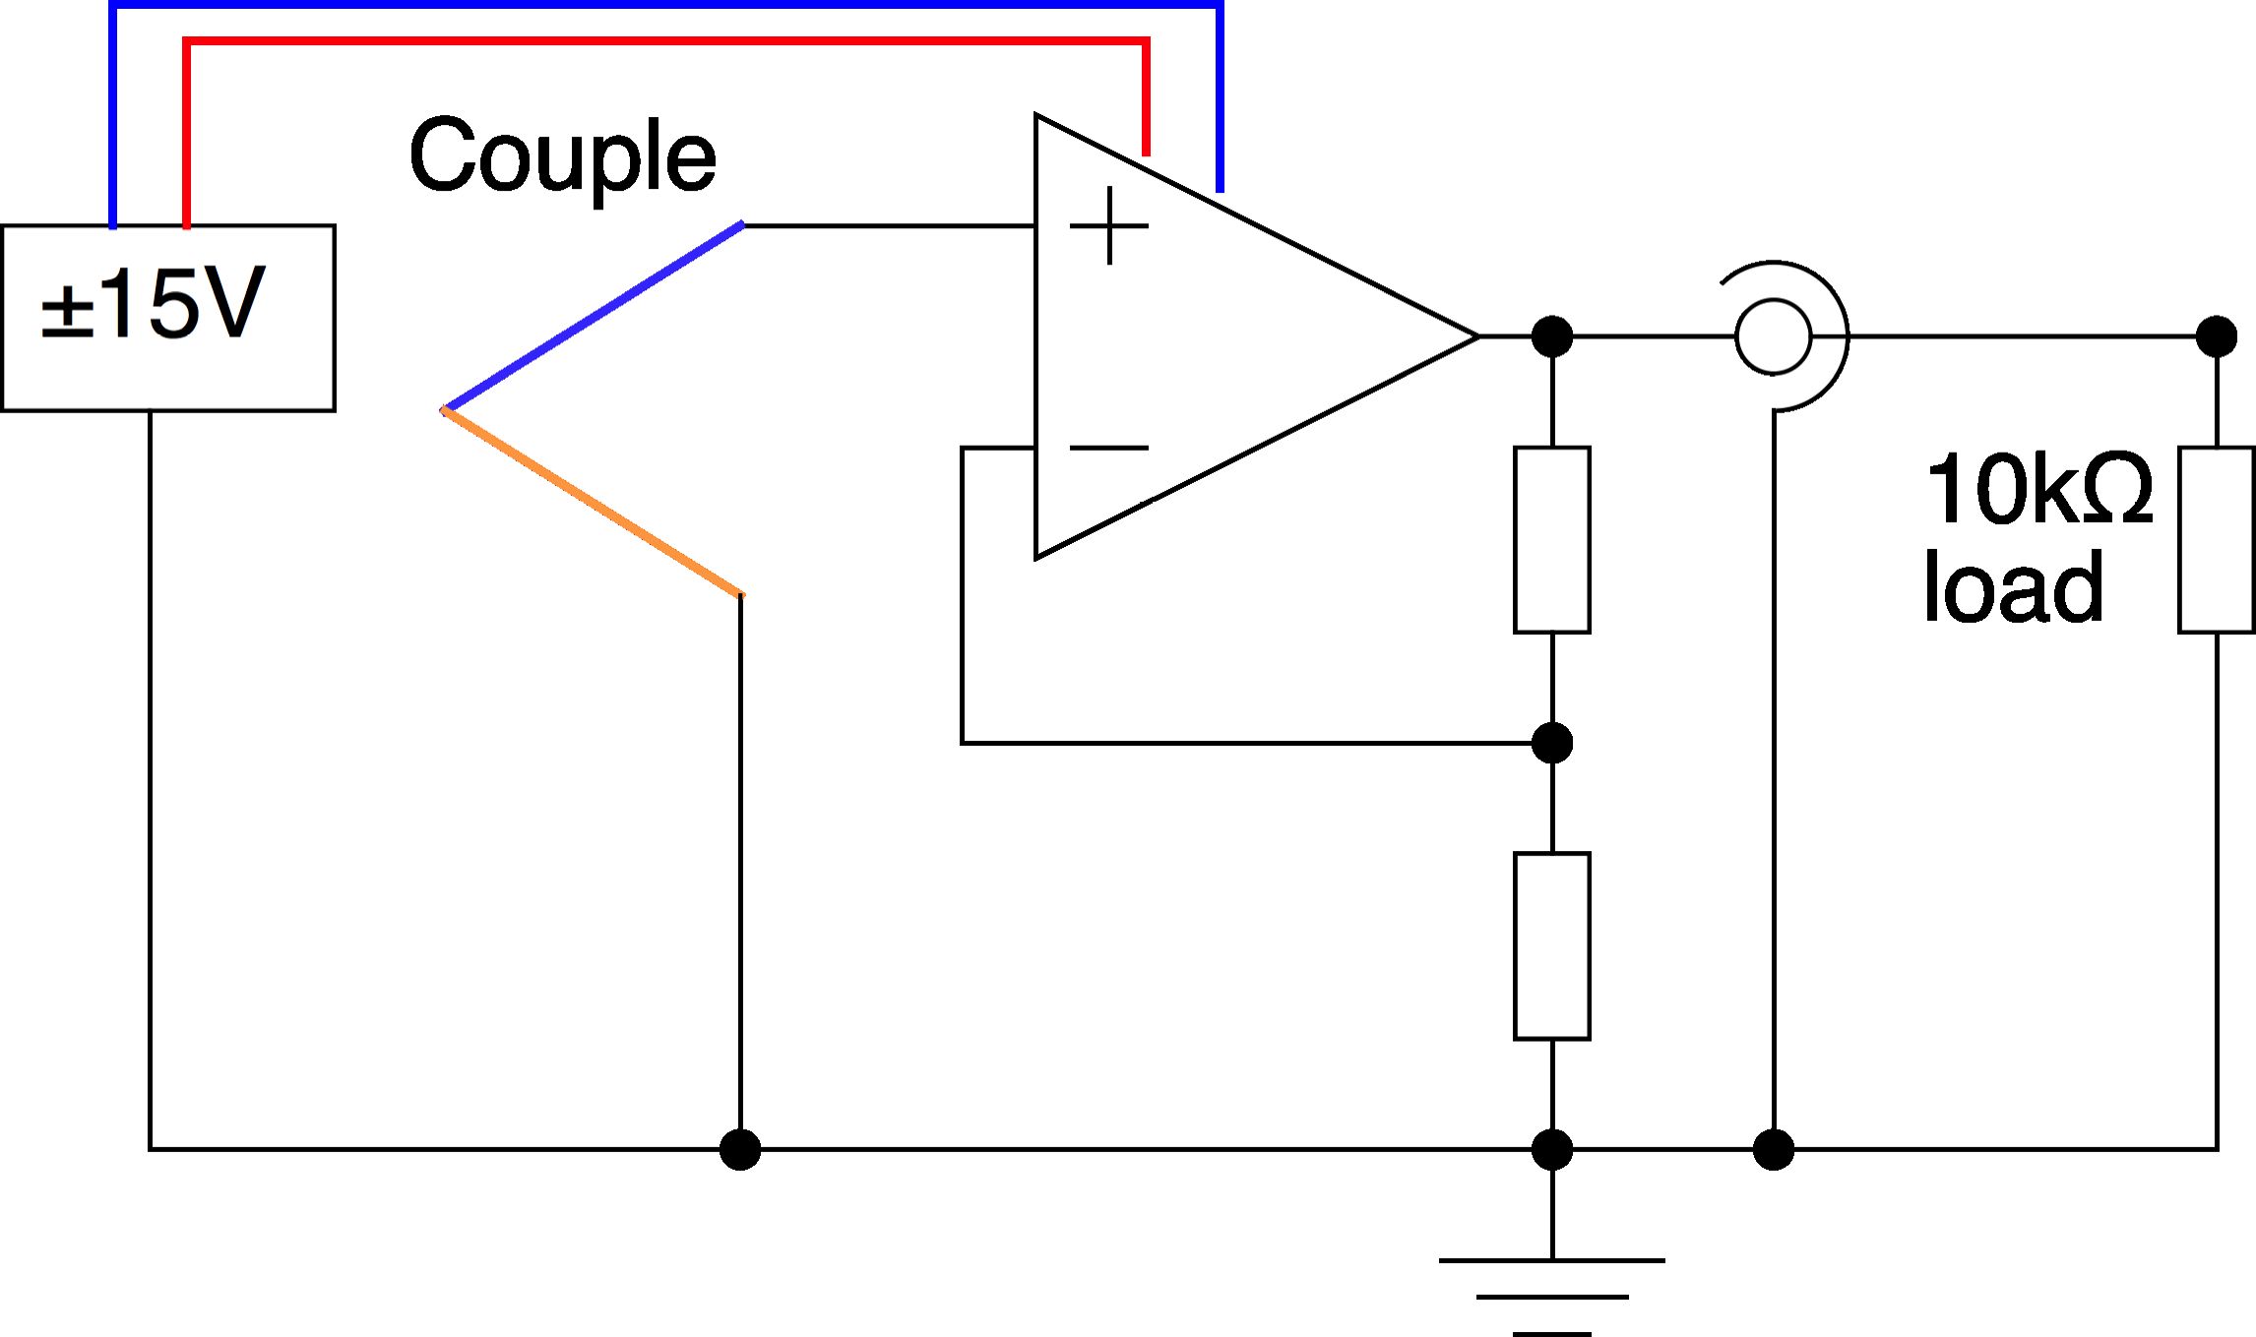
Common-Mode Signals (2)
What you really built
Gain changes with load. 123µV (~2°C error for type K)
Error proportional to load current.

Slide 7
Common-Mode Signals (3)
Worse in any normal system (>1 opamp)
Large currents flow.
Induced voltages depend on
• Loads on other amplifiers
• Signals on other amplifiers
• Details of PCB design
• Quality of soldering
=> Can't design!

Slide 8
Dynamic current for logic
Fast logic is massively worse:

Slide 9

Thank you
谢谢

